Slide 1
360 Control
Manager & Cardholder Training
Commercial Card Payment Solutions

Slide 2
Overview
Manager(s) and Approver(s)
  360 Control provides you with an online Employee Expense Reporting tool allowing you and cardholders to code transactions related to the company’s Visa business card(s). This guide describes the functions available to you as a Manager or Approver.
Cardholders
  This guide will describe how to code and review your transactions to be approved through the Expense Reporting tool.

Slide 3
Contents:
Accessing the System
E-Statement Screen
How to Split a Transaction
How to Add/Edit Comments to a Transaction
How to Attach a Receipt to a Transaction
3 Step Process for Coding/Reviewing/Approving Transactions

Slide 4
Login Instructions
To log in go to: https://360control.firstdata.com/dcal/LandingServlet/?custom=mor0000006&bankId=192737&showLinks=0&language=840
Supported browser: IE 6, 7, 8/For 9, 10, 11 Compatibility View Settings
  Other browsers: pending 2015 release
User Name to be provided
Temporary PW = Welcome1 (capital W and number 1)

Slide 5
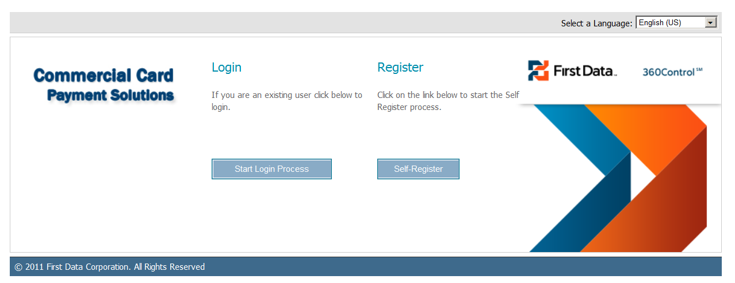
Click on “Start Login Process”

Slide 6
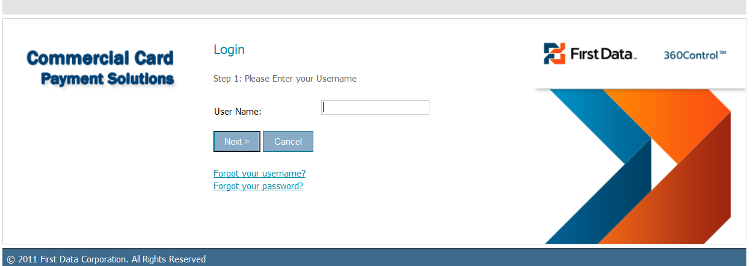
Type in the assigned credential provided to you. It is case sensitive.

Slide 7
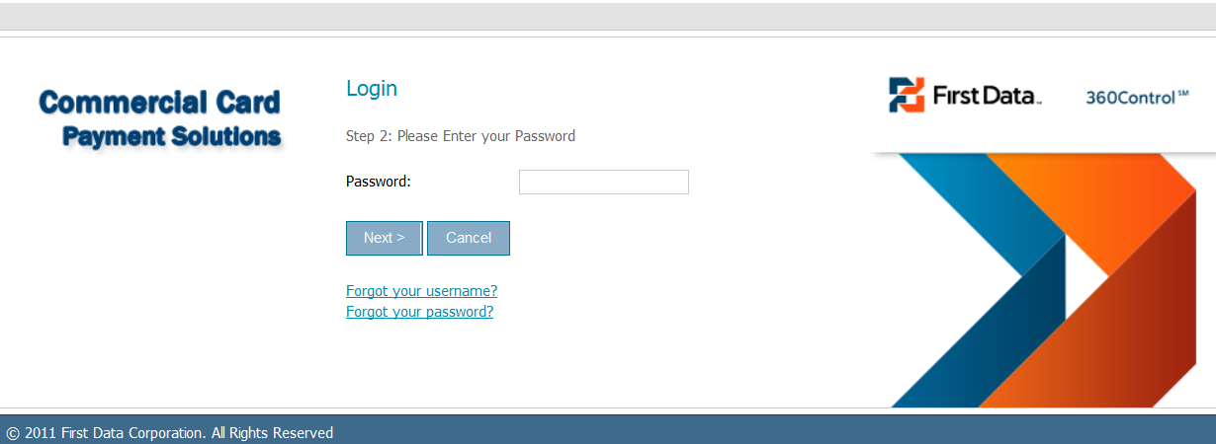
Type in the temporary pw – Welcome1
The system should prompt you to reset.
*Must be a combination of upper and lower case, alpha and numeric characters and be a minimum of 8 characters in length.

Slide 8
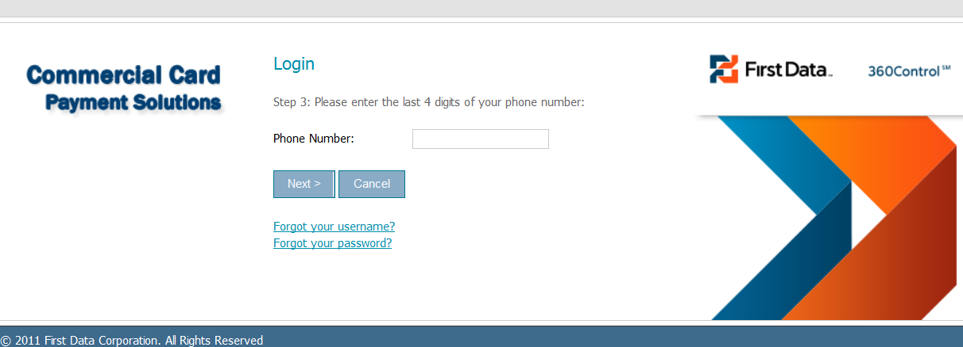
The final step for logging in is a four digit number.
You will be prompted to enter the last four digits of your work telephone number or the last four digits of your card number.

Slide 9
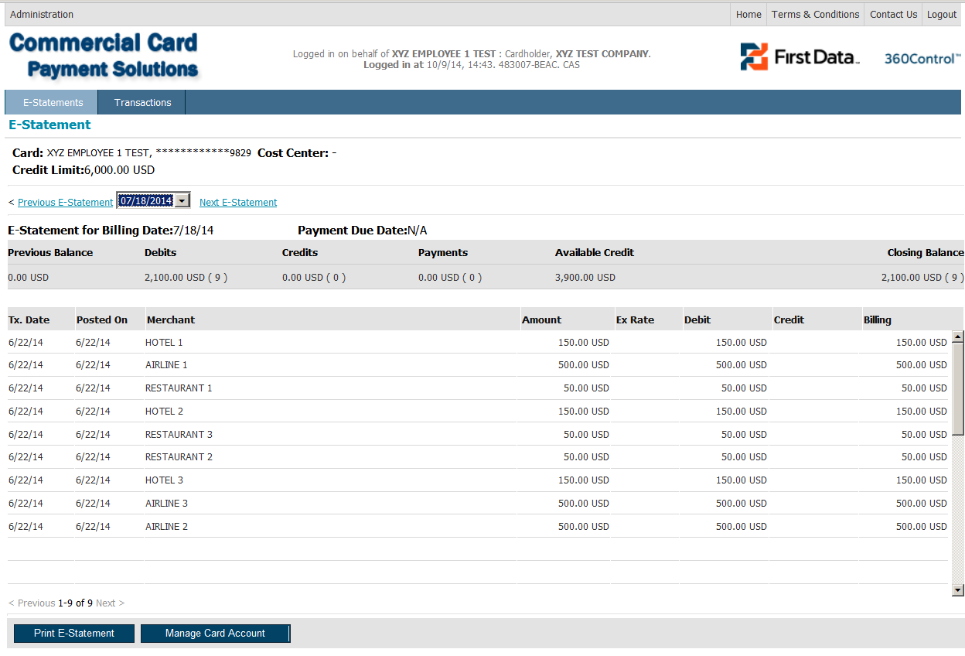
E-Statement Screen:
Once signed in, the E-Statement screen will be the first screen to appear.
The screen contains details of the transactions that have occurred on the account within the most recent billing period. Use the “Previous E-Statement” and “Next E-Statement” hyperlinks to move to other billing cycles/statements.

Slide 10
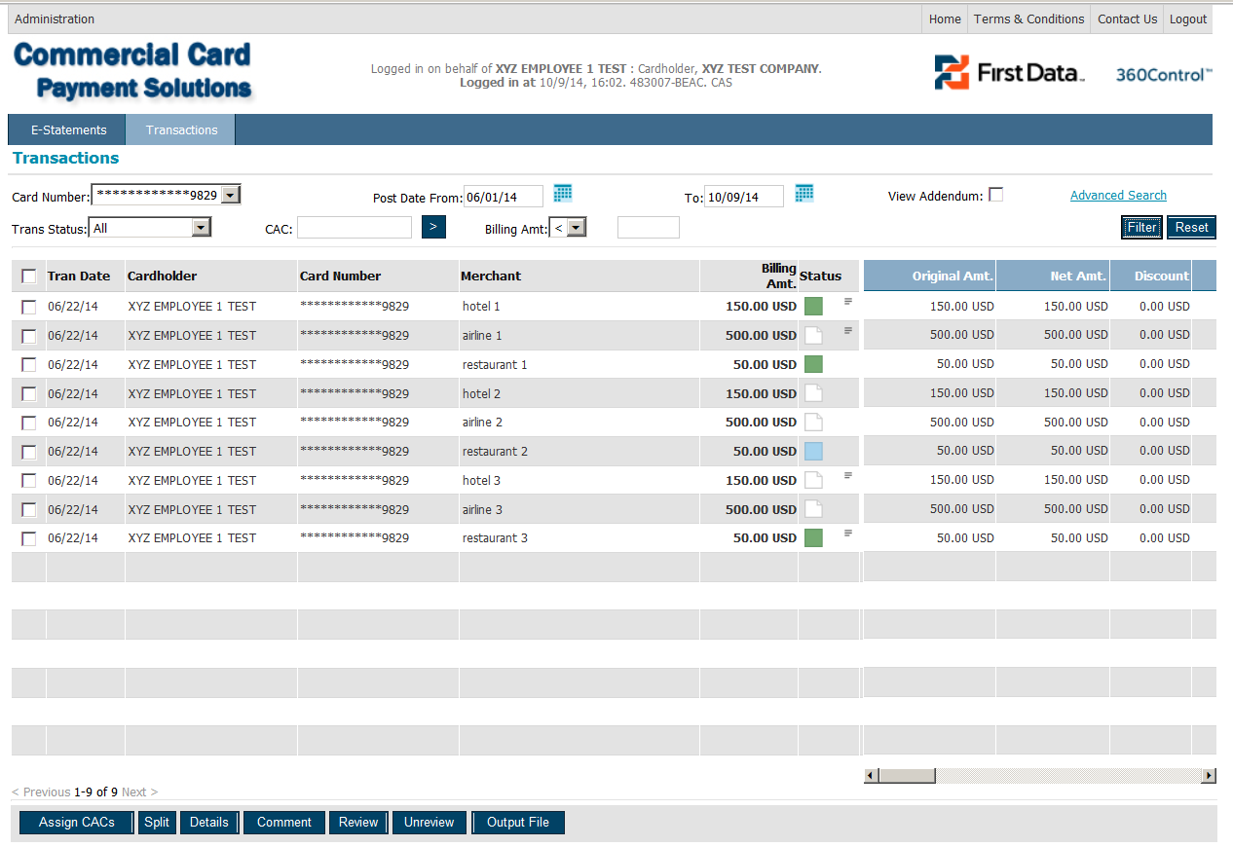
Processing Transactions (3 steps):
Navigate to the Transaction screen. Your current transactions will be displayed. Indicate which transaction you wish to code.
To code your transaction, click on “Assign CACs” located at the bottom of the screen.
To complete the transaction for approval, click on “Review” located at the bottom of the screen.
Transaction can now be approved by a manager/approver.

Slide 11
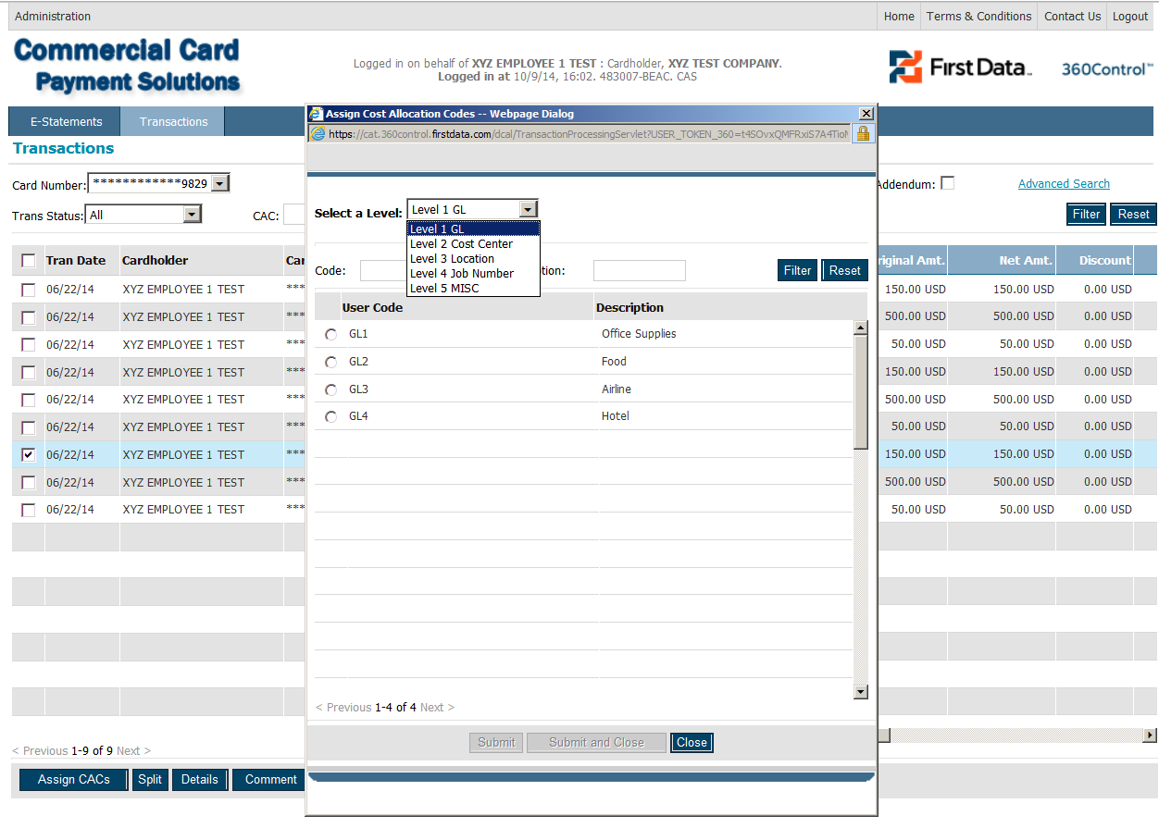
(Step 1) Code Your Transactions:
Select a transaction to change/assign CAC’s by selecting the check box located alongside the far left.
Click “Assign CAC’s” – the Assign Cost Allocation Codes screen appears with Level 1 codes displayed.
Select the Level (Accounting Segment)to assign a code.
Select the Code to apply to the transaction and click Submit.
The selected code will appear by the transaction on the transaction screen.

Slide 12
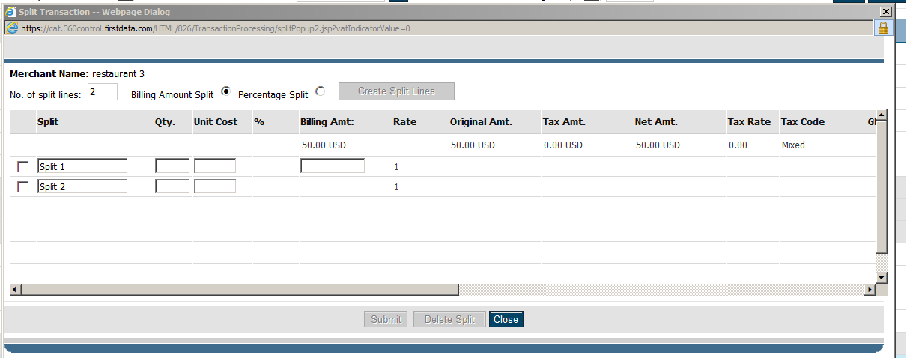
How to Split a Transaction:
Select the check box next to the transaction to be split.
Select “Split” at the bottom of the screen.
The Split dialog box appears with information from the top line (original) transaction.
Enter the number of split lines needed.
Select the format for the split by choosing “Billing Amount Split” or “Percentage Split”.
Click “Create Split Lines”.
By default, the new split lines have a description of Split 1, Split 2 – You may edit these default descriptions.
Enter the amounts in the fields. The last split line field is not editable as it shows the remainder of the total as other split lines are entered. To complete and submit, the total must equal 100%.
CAS codes can only be applied to split lines from the main Transaction screen after creation.
Note: Split transactions can be edited but lines cannot be removed from an existing split. You would need to delete the split and start again.

Slide 13
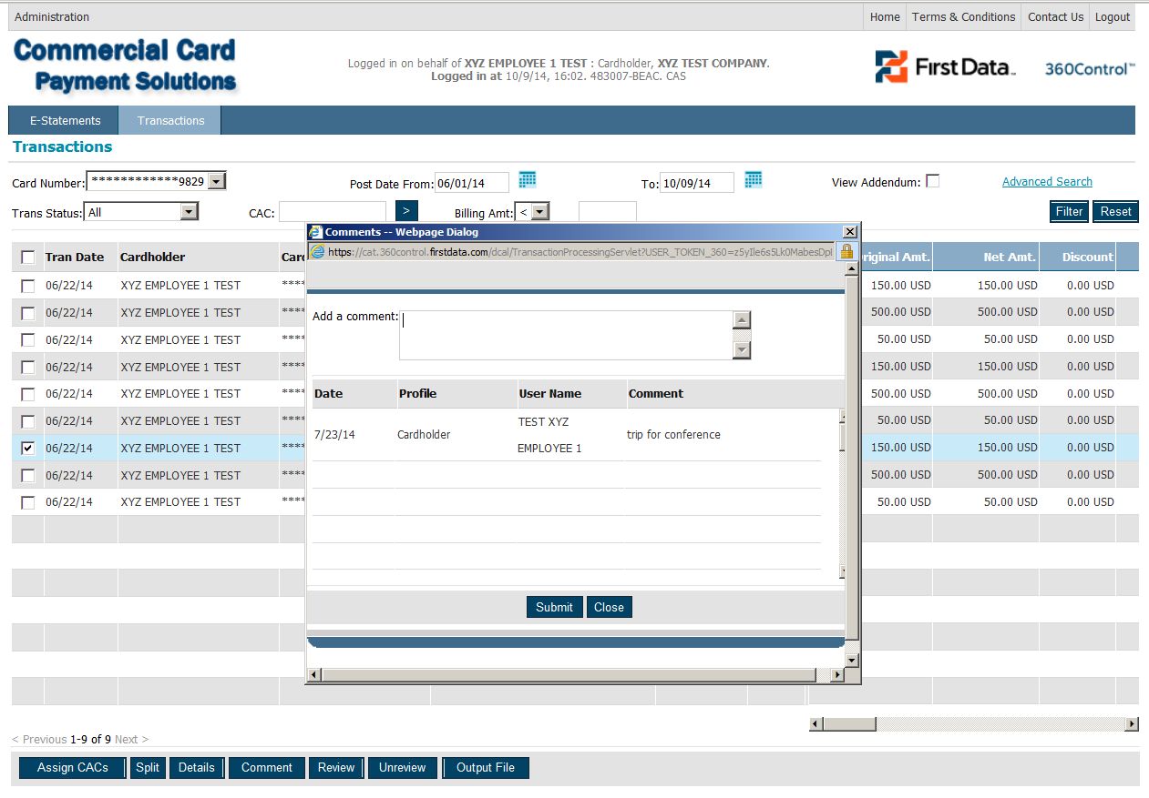
How to Add/Edit Comments on a Transaction:
Select the transaction to apply comments.
At the bottom of the screen, click “Comments”.
In the Comments dialog box, add the comment.
Click “Submit”.
To edit a comment, edit the comment in the dialog box, click submit.

Slide 14

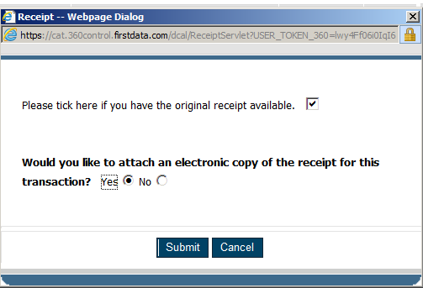
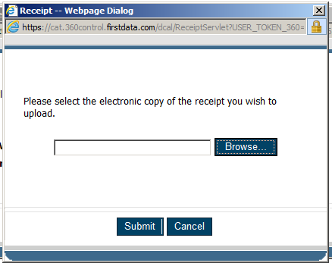
Attaching a Receipt to a Transaction:
Click on the paperclip icon located on the left of the first cost allocation column.
A window will open asking if you would like to attach an electronic copy of the receipt. Choose “Yes” and click on “Submit”.
A second window will open allowing you to browse and locate the file with the copy of the receipt. After browsing and locating, click on Submit.
Paperclip icon
First window
Second window

Slide 15
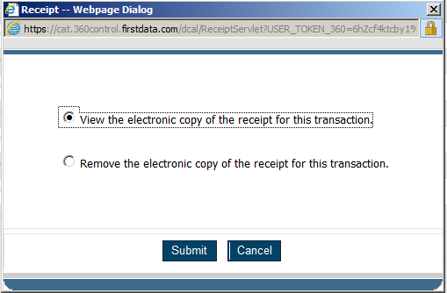
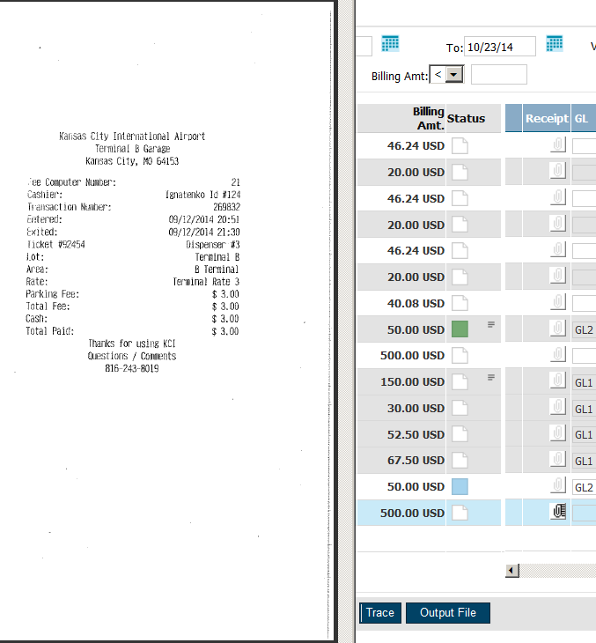
Attaching a Receipt to a Transaction contd:
To view the receipt once it has been attached, click on the paperclip icon again (now darkened).
A window will appear asking if you would like to view the receipt or remove it. Choose view and click Submit.
An image of the receipt will appear.
First window
Image of receipt displays

Slide 16
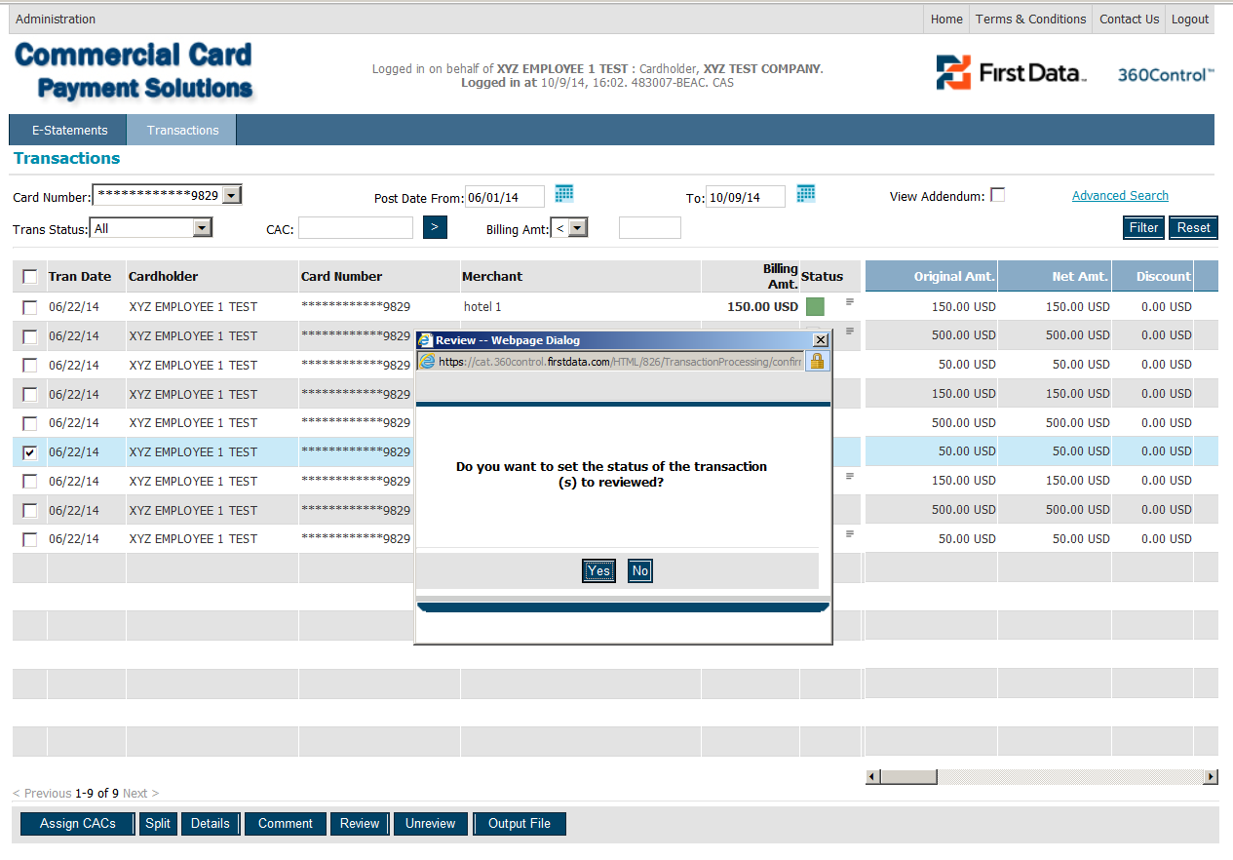
(Step 2) Review Transaction(s):
Once you have completed all coding for transactions, you must review them so that your designated transaction Approver can move through the approval process.
Select the transaction(s) by selecting the check box located at the far left.
Click Review.
The dialog box asking if you want to set the status to reviewed will appear.
Click Yes.
The transaction(s) will now appear in your approver’s view with a status of Reviewed – (Blue).

Slide 17
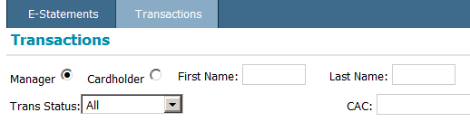
(Step 3) Approvers → How to Approve a Transaction(s):
If you are a Cardholder/Approver, you are responsible for approving transactions for a number of cards and those on your own card as well. As a Cardholder/Approver, the Transaction screen is available in two views.
Cardholder View
This view displays details of transactions that occur on your own card which require processing.
Manager (Approver) View
This view displays details of transactions that have occurred on other cardholder’s cards that have been reviewed, for which the approver is responsible. Your reviewed transactions will also appear in this view.
A Cardholder/Approver can switch views by selecting Manager or Cardholder on the Transaction Screen.

Slide 18
Approving Cardholder Transactions:
In Manager Mode/View:
In the Trans Status List on the Transactions screen, select Reviewed.
You can also refine your filter search by specifying the name or card number of the cardholder for which you want to approve transactions.
Click Filter. A list of reviewed transactions for the cardholder(s) appears.
Check that the transaction(s) has been coded correctly with the correct cost allocation and that the transaction that has been made is legitimate for work purposes.
To select the transaction(s) to approve, select the check box located at the far left.
Click Approve in the function panel at the bottom of the screen. The status will now be changed to Green.
From and To Dates:
The From and To Dates located on the Transaction screen will always default to the current billing period. If you need to review transactions for the previous billing period, change the calendar dates in the filter panel. Once the dates have been selected – click on Filter to display the results.

